Slide 1


Guidelines for the Required
School Site Council (SSC) and
English Learner Advisory Committee (ELAC)
Orientation
Normas para el Requerido
Consejo del Plantel Educativo (SSC)
y el Comité Asesor para Aprendices de Inglés
Orientación
BUL 6745.2 Guidelines for the Required School Site Council and English Learner Advisory Committee
BUL 6745.2 Normas para el Requerido Consejo del Plantel Educativo y el Comité Asesor para Aprendices de Inglés
Notes:
Good morning:
This orientation is for both the school’s SSC and the ELAC committees.
We will be reviewing this morning the items that pertain to both SSC and ELAC and then we will focus on the purpose and responsibilities of the SSC and then on the ELAC.
Please place your questions on a post it and place them on our Parking Lot section.
Click

Slide 2


Welcome Bienvenidos
Principal
Director(a)
Assistant Principal
Asistente del Director(a)
Administrative Secretary
Secretaria (o) Administrativa(o)
School Title I Designee
Designada(o) del Programa Título I
English Learners Program Designee
Designada(o) del Programa de Aprendices de Ingles
name
name
name
name
name
School Leadership Team|Equipo de Liderazgo de la Escuela
Notes:
Introduction and welcome of key staff at school site.
Click

Slide 3
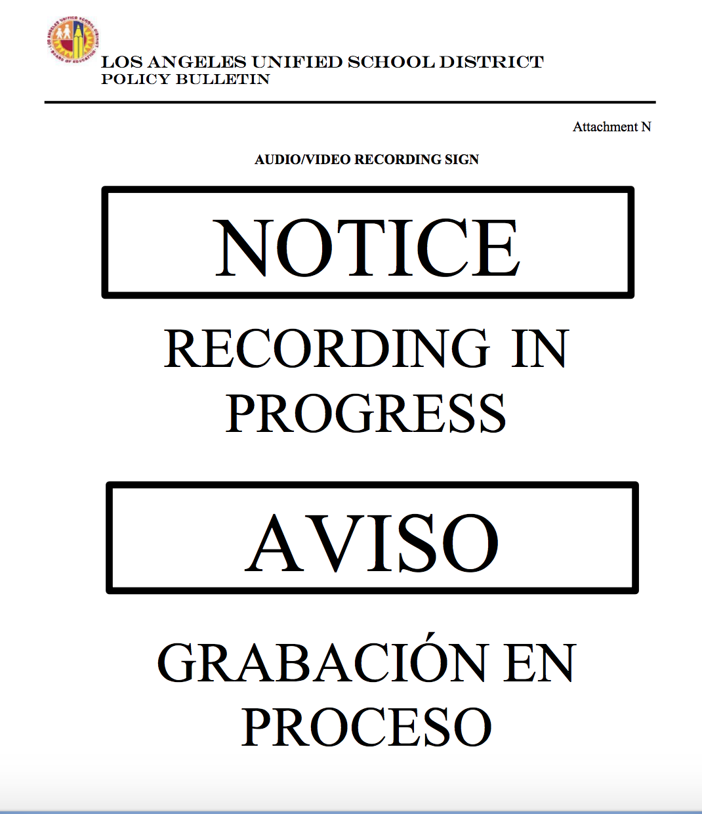

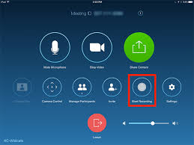

SIGN IN
Attendance: Welcome and please sign in on the Chat. Please enter your first and last name and indicate if you are a parent/legal guardian, community member, or visitor. Parents/legal guardians please also type your child’s first and last name.
Anótese
Asistencia: ¡Bienvenidos! Por favor, escriba su nombre en la función de “Chat”. Por favor escriba su nombre y apellido e indique si usted es padre,madre/tutor legal, miembro de la comunidad, o visita. Padres|Madres|Tutores legales: por favor también escriban el nombre y apellido de su hijo|hija.

Slide 4
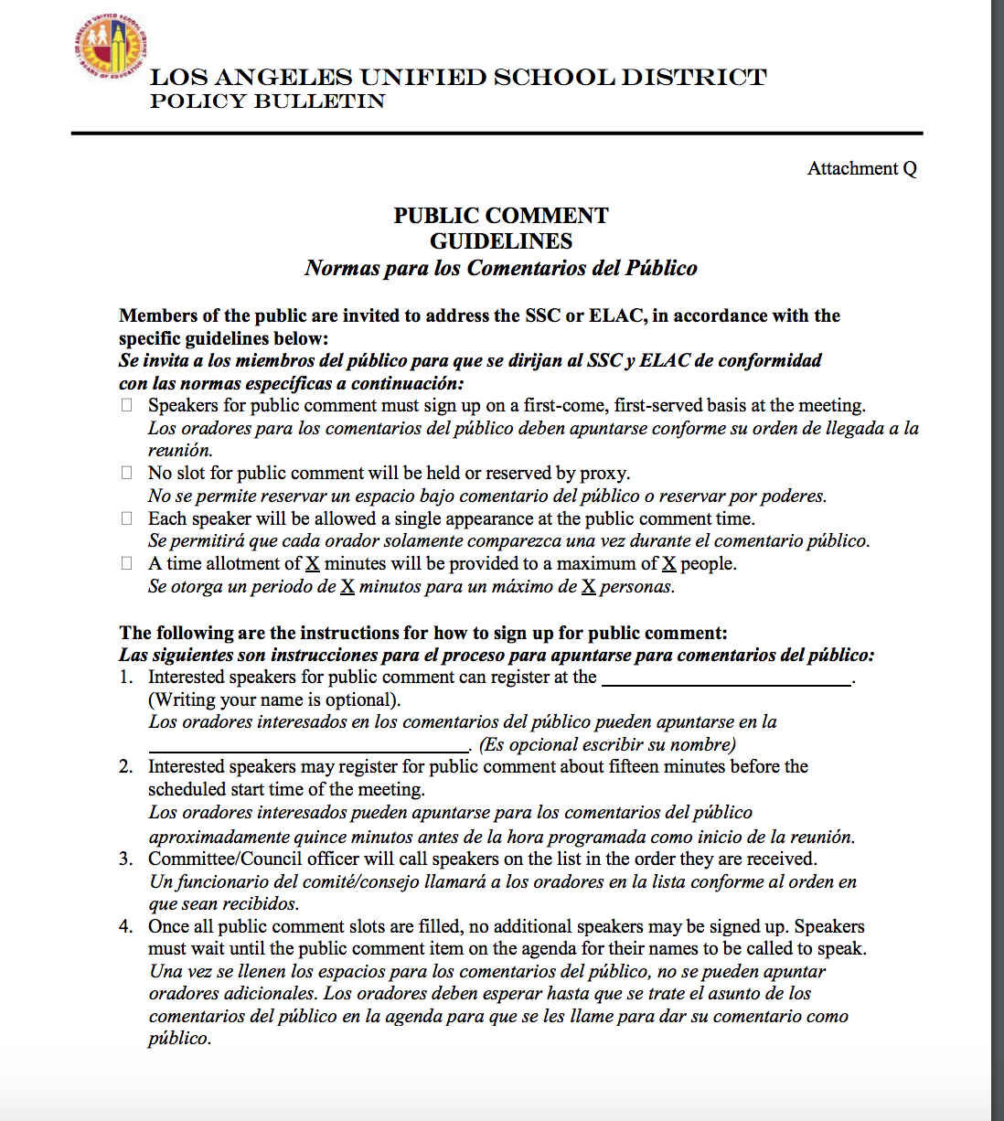

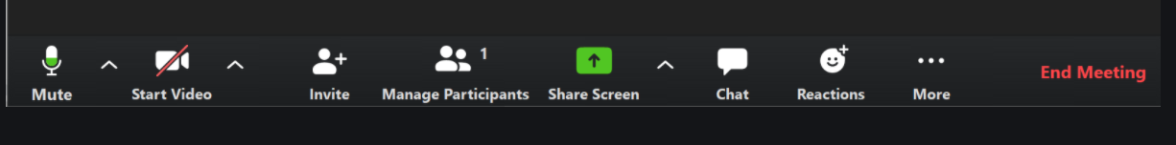
Public Comments: A time allotment of X minutes per person will be provided to a maximum of X people.
Comentarios Públicos:
Se otorga un período de X minutos por persona, para un máximo de X personas.
Public Comments opportunity on a first come first served basis. Indicate this on chat by including your name and write in public comment request.
La oportunidad para hacer comentarios públicos se darán en el orden en que aparece el nombre de la persona en el “chat” que ha indicado su deseo de hacer un comentario público.
Notes:
Make sure that the number of minutes/number of speakers match what was indicated on the posted agenda.
Explain that if anyone is interested in speaking during Public Comment, they can sign up for Public Comment by typing in the Chat (staff can provide assistance, as needed). Staff will help callers sign up if they are interested in speaking during Public Comment.

Slide 5
Interpretation Services Servicios de Interpretación
Click on the globe icon at the bottom of the screen.
Select the language of preference for you.
You will engage and listen to the presentation in the language you select.
Haga clic en el símbolo del mundo en la parte de abajo de su pantalla.
Seleccione el idioma que le gustaría escuchar.
Participará y escuchará la presentación en el idioma que seleccione.
Notes:
Read

Slide 6

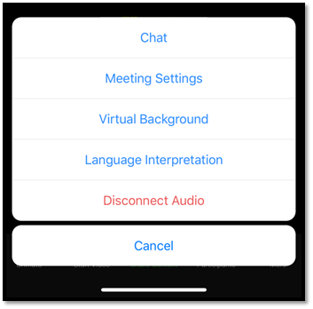

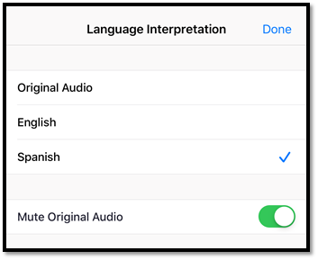

Interpretation Services on Mobile Device
Servicios de Interpretación por Aparato Móvil
Notes:
If you are joining us via your phone you will notice three dots.
Please hovers over the three dots and click on Language Interpretation and select your language of Preference.
Please note that in order to avoid any feedback you must select a language.

Slide 7
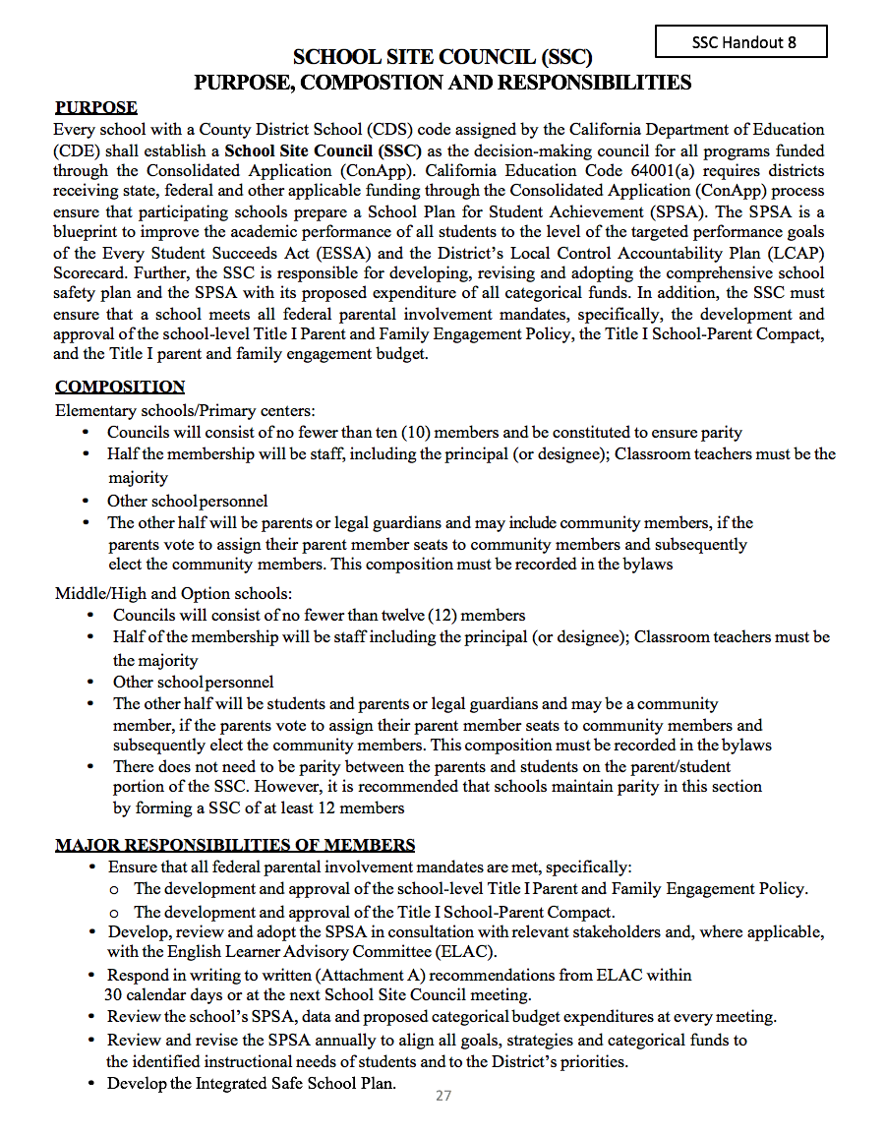
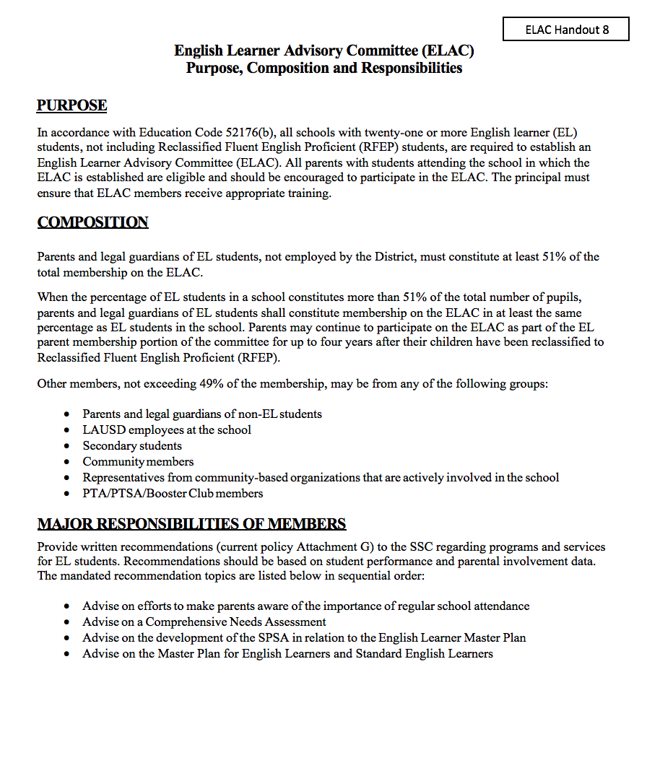
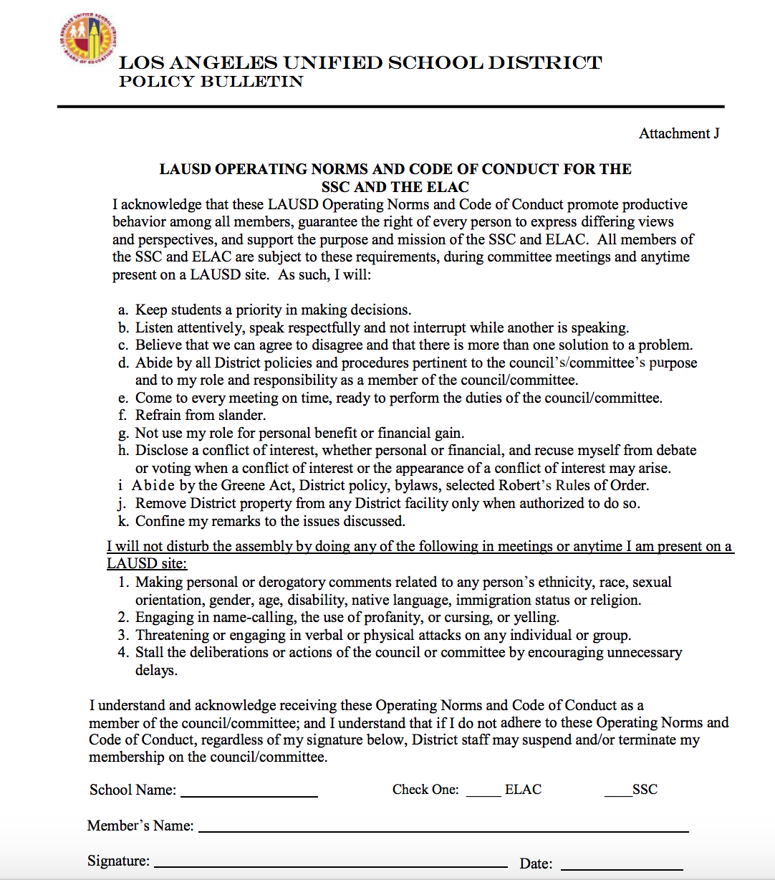
SCHOOL SITE COUNCIL (SSC)
PURPOSE, COMPOSTION AND RESPONSIBILITIES
(SSC Handout #8)
https://bit.ly/SSCPurposeCompositionandResponsibilitiesEnglish
https://bit.ly/SSCPurposeCompositionandResponsibilitiesSpanish
English Learner Advisory Committee (ELAC) PURPOSE, COMPOSTION AND RESPONSIBILITIES
(SSC Handout #8)
https://bit.ly/ELACPurposeandFunctionEnglish
https://bit.ly/ELACPurposeandFunctionSpanish
LAUSD OPERATING NORMS AND CODE OF CONDUCT FOR THE SSC AND THE ELAC (BUL- 6745.2- Att. J)
https://bit.ly/ELACandSSCNormsEnglish
https://bit.ly/ELACandSSCNormsSpanish

Slide 8
Agenda Agenda
English Agenda
Spanish Agenda
Please insert your school agenda that was posted.
Notes:
Please add agenda or agenda items in English and spanish

Slide 9

Pledge of Allegiance Juramento a la Bandera
I pledge allegiance to the flag
of the United States of America
and to the Republic for which it stands,
one nation under God, indivisible,
with liberty and justice for all.
Prometo lealtad a la bandera de los Estados Unidos de América y a la Republica que representa, una Nación ante Dios, indivisible con libertad y justicia para todos.

Slide 10
Public Comments: A time allotment of X minutes per person will be provided to a maximum of X people.
Comentarios Públicos:
Se otorga un período de X minutos por persona, para un máximo de X personas.
PUBLIC COMMENT GUIDELINES
(BUL-6745.2- Att. Q)
http://bit.ly/PublicCommentGuidelines_NormasParaComentariosPublico
Notes:
Public Comment: Please ask staff member to call name of people that signed up for public comment.

Slide 11


General Guidelines that Apply For School Site Council (SSC) and English Learner Advisory Committee (ELAC)
Guías generales que aplican al Consejo del Plantel Educativo (SSC) y al Comité consejero de Aprendices de Inglés (ELAC)
Schools and families working together to ensure student success
Escuelas y familias trabajando unidas para asegurar el éxito estudiantil
BUL 6745.2 Guidelines for the Required School Site Council and English Learner Advisory Committee
BUL 6745.2 Normas para el Requerido Consejo del Plantel Educativo y el Comité Asesor para Aprendices de Inglés
Notes:
We are now going to start with General Guidelines that apply for the School Site Council and the English Learner Advisory Committee as described in BUL 6745.2 Guidelines for the Required School Site Council and English Learner Advisory Committee.

Slide 12
Purpose Propósito
Repasar los deberes y la función del requerido Consejo del Plantel Educativo (SSC, por sus siglas en inglés) y el Comité Asesor para Aprendices de Inglés (ELAC, por sus siglas en inglés)
Entender las funciones y responsabilidades de los miembros del Consejo del Plantel Educativo (SSC) y el Comité Asesor para Aprendices del Inglés (ELAC)
Entender el proceso de la orientación y elecciones para SSC y ELAC
To review the functions and operation of the mandated School Site Council (SSC) and the English Learner Advisory Committee (ELAC)
Understand the roles and responsibilities of the School Site Council Committee (SSC) and English Learner Advisory Committee (ELAC) members
Understand the orientation and election process for the SSC and ELAC
Notes:
Read the purpose for todays meeting as outlined in slide 12.

Slide 13

Greene Act Decreto Greene
The SSC and ELAC operate under the Greene Act which means that the meetings must:
  Be conducted as public meetings with agendas posted 72 hours before the meeting outside of the school building in a plainly visible location.
  The agenda must specify the date, time, and location of the meeting, the items to be addressed, and whether the items will require action to be taken.
  A council/committee generally, may only act on or consider an item when it has been properly included on the agenda at the time of posting.
El SSC e ELAC se rigen por el Decreto Greene que significa que las reuniones deben de:
  Llevarse a cabo como reuniones públicas con agendas publicadas con 72 horas de anticipación a la reunión, fuera del recinto escolar en una ubicación fácilmente visible.
  La notificación (agenda) debe especificar la fecha, la hora, y lugar de la reunión y los puntos que se abordarán y si los puntos requieren que se tome alguna acción.
  Un consejo/comité, por lo general, solo puede actuar o considerar un asunto cuando éste se ha incluido debidamente en la agenda al momento de su publicación.
Notes:
The SSC and ELAC operate under the California Open Meeting Law provisions of the Greene Act which means that the meetings must be conducted as public meetings with agendas posted 72 hours before the meeting outside of the school building in a plainly visible location, and must be posted at the meeting location, if different than the school site. The agenda must specify the date, time, and location of the meeting, the items to be addressed, and whether the items will require action to be taken. A council or committee, generally, may only act on or consider an item when it has been properly included on the agenda at the time of posting. If action is taken on an item that was not listed as an action item on the agenda, the action taken is invalidated.

Slide 14
Greene Act Decreto Greene
  If action is taken on an item that was not listed as an action item on the agenda, the action taken is invalidated.
Only under certain unusual circumstances and by a unanimous vote may the council or committee allow an item not on the agenda to be considered and/or acted upon.
When considering whether or not to allow a non-agenda item, the council or committee must determine if the item presents an urgent need for action, and the item/issue was unknown at the time the agenda was posted.
  Si se ejecuta una acción referente a un asunto que no se enumeró en la agenda como un asunto por tratar, la acción que se ejecute no será válida.
Únicamente bajo ciertas circunstancias excepcionales y por un voto unánime, el comité puede permitir que un asunto que no está en la agenda se considere y/o se tome alguna acción acerca del mismo.
Al considerar si se permite o no un asunto que no está en la agenda, el comité debe determinar si el asunto presenta una necesidad urgente que requiere acción y el tema / problema no se conocía en el momento en que se publicó la agenda.
Notes:
An item that was not posted on the agenda can be added but it does need to have unanimous vote. The council or committee really needs to determine the urgency of the matter being proposed and the fact that this information was not known at the time the agenda was planned. As a reminder the public has the right to know when an item is being considered for action by a council or committee.

Slide 15

SSC and ELAC Agenda Agenda para SSC y ELAC
In all cases, the SSC/ELAC agenda items must have relevance to the purpose and goals of the SSC/ELAC
The SSC/ELAC officers must participate in the planning of the agenda with designated school staff.
Changes to the SSC/ELAC agenda planned by the respective officers, before the posting of the meeting, must be in consultation with the SSC/ELAC officers.
All SSC/ELAC agendas must contain a public comment section.
En todos los casos, los asuntos de la agenda de SSC/ELAC deben ser relevantes al propósito y los objetivos de SSC/ELAC.
Los funcionarios de SSC/ELAC deben de participar en la planificación de la agenda con el personal escolar que sea designado.
Los cambios a la agenda de SSC/ ELAC deben ser planificados por sus respectivos funcionarios antes de la publicación de dicha reunión y se debe de hacer en consulta con los funcionarios de SSC/ ELAC.
Todas las agendas de ELAC/SSC deben de incluir una sección para los comentarios del público.
Notes:
This slide is a reminder for all that the SSC and ELAC agendas must contain items that are relevant to the purpose and goals of the SSC and or ELAC.
We also would like to state that the SSC/ELAC officers will be part of the planning of the agenda and any changes which happens before the agenda is posted will be with consultation of the officers.
As was mentioned in the previous slide any changes to the agenda after the 72 hours posting must take place with the members voting on the changes.

Slide 16

Public Comment Comentarios Públicos
During the public comment section on the agenda, any member of the public may address the body on any item within the jurisdiction of the council or committee in accordance with the Greene Act. Writing their name on a sign-in form is optional.
Anyone who is not serving as a member of the operating council or committee is considered a member of the public.
Dentro de la sección de comentarios públicos en la agenda, cualquier miembro del público puede dirigirse a la membresía acerca de cualquier artículo dentro de la jurisdicción del consejo/comité, de acuerdo con el Decreto Greene. Escribir su nombre en la lista de asistencia es opcional.
Cualquier persona que no funja como miembro del consejo o el comité es considerado como miembro del público.
Notes:
During the public comment section on the agenda, any member of the public may address the body on any item within the jurisdiction of the council or committee in accordance with the Greene Act. Anyone who is not serving as a member of the operating council or committee is considered a member of the public.

Slide 17
Public Comment Comentarios Públicos
Seated SSC or ELAC members cannot speak during public comment.
Public speakers may be limited to speak for 1, 2 or 3 minutes. It is advised to inform the public of such a rule at the start of every meeting. Such rule should be applied evenly to all speakers. Public speakers have the option of not signing in.
A timer or clock should be displayed to monitor the length of time allotted to each public speaker.
Los miembros de SSC o ELAC no pueden hablar durante los comentarios del público.
Se puede limitar a los oradores del público para que hablen durante 1, 2, o 3 minutos. Se recomienda informar al público de dicho reglamento al principio de cada reunión. Este reglamento debe aplicarse de forma uniforme para todos los oradores. Los oradores públicos tienen la opción de no inscribirse en la lista de asistencia.
Debería utilizarse un cronómetro o un reloj para monitorear el tiempo que se le adjudica a cada orador público.
Notes:
Seated SSC or ELAC members cannot speak during public comment. All SSC/ELAC bylaws must include a standing rule regarding public comment procedures, including the number of speakers and the length and frequency of public comment. Public speakers may be limited to speak for 1, 2 or 3 minutes. It is advised to inform the public of such a rule at the start of every meeting. Such rule should be applied evenly to all speakers. Members of the Public that would like to speak during public comment time do not have to sign-in or explain why they want to speak during this time. A timer or clock should be displayed to monitor the length of time allotted to each public speaker. The form to register speakers for public comment should be collected immediately prior to the public comment agenda item.

Slide 18

SSC/ELAC Members’ Responsibilities
Responsabilidades de los miembros del SSC/ELAC
Asistir a todas las reuniones.
Votar en persona.
Seguir las Normas de Funcionamiento y el Código de Conducta.
Llegar a un acuerdo en cuanto a las fechas y horarios para las reuniones. El director escolar puede convocar reuniones adicionales conforme se necesiten con la consulta de los funcionarios del SSC/ELAC
Attend all meetings.
Vote in person.
Follow the Operating Norms and Code of Conduct.
Agree on the dates and times of meetings by vote at the first official business meeting, as possible. The principal may call additional meetings as needed in consultation with SSC/ELAC officers.
Notes:
We would like to encourage you to become a member of the ELAC and or SSC committees/Councils at our school. These are the important responsibilities what SSC and ELAC members have when they become members. Read the slides…

Slide 19
SSC/ELAC Members’ Responsibilities
Responsabilidades de los miembros del SSC/ELAC
Participate in trainings to carry out their duties effectively.
Honor all decisions of the SSC/ELAC, even if these decisions differ from one’s personal opinions.
Resign from their position at any time, but must do so in writing, and must submit the signed letter of resignation to the principal or administrative designee.
Participar en todas las sesiones de capacitación para realizar sus funciones con eficacia.
Respetar todas las decisiones del SSC/ELAC, aun cuando dichas decisiones sean diferentes a las opiniones personales.
Renunciar a su puesto en cualquier momento, pero debe hacerse por escrito y se debe entregar una carta de renuncia firmada al director o persona administrativa asignada.
Notes:
We would like to encourage you to become a member of the ELAC and or SSC committees/Councils at our school. These are the important responsibilities what SSC and ELAC members have when they become members. Read the slides…

Slide 20
ORIENTATION FOR THE
SCHOOL SITE COUNCIL (SSC)
ORIENTACIÓN PARA
EL CONSEJO DEL PLANTEL EDUCATIVO (SSC)
Schools and families working together to ensure student success
Escuelas y familias trabajando unidas para asegurar el éxito estudiantil
BUL 6745.2 Guidelines for the Required School Site Council and English Learner Advisory Committee
BUL 6745.2 Normas para el Requerido Consejo del Plantel Educativo y el Comité Asesor para Aprendices de Inglés
Notes:
We are now going to start the orientation for the School Site Council. I will be explaining the role and responsibility of the SSC as described in BUL 6745.2 Guidelines for the Required School Site Council and English Learner Advisory Committee.

Slide 21
Pursuant to CA Education Code 65000 and 32281 (2)
Secciones 65000 y 32281 del código de educación (2)
Cada escuela con un código como escuela de Distrito del Condado (CDS) por la Secretaría de Educación del Estado de California (CDE) debe establecer un Consejo del Plantel Educativo (SSC) como un consejo de toma de decisiones para todos los programas financiados a través de la Solicitud Consolidada (ConApp).
Every school with a County District School (CDS) code assigned by the California Department of Education (CDE) shall establish a School Site Council (SSC) as the decision-making council for all programs funded through the Consolidated Application (ConApp).
Notes:
Why do we have an SSC…. Because it is required by law.
Since it’s required by law we need to insure we comply in order to insure we have access to the additional funds that support our Title I programs that provide additional academic resources for students.

Slide 22
Pursuant to CA Education Code 64001 (A)
Código de Educación
64001 (a)
Requires districts receiving federal, state and other applicable funding, through the ConApp process, ensure that participating schools prepare a School Plan for Student Achievement (SPSA)
Requiere que los distritos que reciben fondos estatales, federales u otros fondos aplicables mediante el proceso de la Solicitud Consolidada, se aseguren que las escuelas participantes desarrollen un Plan Escolar para el Rendimiento Académico Estudiantil (SPSA):
Notes:
As SSC members your main responsibility is the School Plan for Student Achievement which outlines the instructional programs and services that our Title I Students receive. In addition to stating the how we are using our Title I funds to increase student Academic Achievement.
The ConApp or Consolidated Application is the document submitted to the state by LAUSD in order to receive our State/Federal funds.

Slide 23
Consejo del Plantel Escolar: Funciones y Responsabilidades
FUNCTION OF SSC:
Functions and Responsibilities
Develop, review and adopt the SPSA in consultation with relevant stakeholders and, where applicable, with the ELAC.
Respond in writing to ELAC’s written recommendations on the SPSA within 30 calendar days or at the next SSC meeting.
Ensure that all federal parental and family engagement mandates are met.
Develop the Integrated Safe School Plan, as described in Reference Guide 5511.8.
Desarrollar, revisar y adoptar el SPSA en consulta con las partes interesadas relevantes y cuando corresponda, con ELAC.
Responder por escrito a las recomendaciones escritas del ELAC, dentro de un período de 30 días calendario o durante la siguiente reunión del SSC.
Asegurar que se cumplan todos los mandatos federales para la involucración de los padres y las familias.
Desarrollar el Plan Integrado de Seguridad Escolar, conforme de describe en la Guía de Referencia 5511.8.
The SSC is a decision-making council for all programs funded through the Consolidated Application.
El SSC es un consejo que toma decisiones en relación a todos los programas que son financiados mediante la Solicitud Consolidad.
Notes:
This slide describes the functions and responsibilities of the SSC. Read the four bullets.
See page 2 of BUL 6745.2 for detail information regarding the functions and responsibilities of the SSC.
Important to remember that SSC is a decision making council….The principal does not have veto power on SSC decisions and all members of the SSC have an equal vote.

Slide 24
Deberes del SSC:
Desarrollar el Plan Integrado de Seguridad Escolar
FUNCTION OF SSC:
Develop the Integrated Safe School Plan
Develop the Integrated Safe School Plan, as described in Reference Guide 5511.8.
The SSC may delegate the responsibility of developing the Integrated Safe School Plan to a school safety planning committee.
Desarrollar el Plan Integrado de Seguridad Escolar, conforme se describe en la Guía de Referencia 5511.8.
El SSC puede delegar la responsabilidad de desarrollar un plan integrado de seguridad escolar a un comité de planificación de la seguridad escolar.
Notes:
So lets talk a little bit more regarding the SSC roles in developing the Safe School Plan.
Read the slide and describe the option that the SSC has in delegating this responsibility to a Safety Planning Committee.

Slide 25
Deberes del SSC:
Desarrollar el Plan Integrado de Seguridad Escolar
FUNCTION OF SSC:
Develop the Integrated Safe School Plan
According to California Education Code 32281(2), this school safety planning committee must be comprised of the following members:
  Principal or principal’s designee
  One teacher who is a representative of the recognized certificated employee organization
  One parent whose child attends the school
  One classified employee who is a representative of the recognized classified employee organization
  Other members, if desired.
De conformidad con el Código de Educación del Estado de California 32281 (2), este subcomité de planificación para la seguridad escolar debe estar integrado por lo mínimo por las siguientes partes interesadas:
  Director escolar o persona designada
  Un maestro que es un representante de una organización reconocida para los empleados certificados
  Un padre de familia cuyo hijo asiste a la escuela
  Un empleado clasificado que es un representante de una organización reconocida para los empleados clasificados
  Otros miembros, si así se desea.
Notes:
So lets talk a little bit more regarding the SSC roles in developing the Safe School Plan.
Read the slide and describe the option that the SSC has in delegating this responsibility to a Safety Planning Committee.

Slide 26

FUNCTION OF SSC:
Federal Mandates
DEBERES DEL SSC: MANDATOS FEDERALES
Asegurar que todos los mandatos federales, que incluye aquellos para la participación de los padres, se cumplan, específicamente:
El desarrollo y la aprobación de la Política del Título I para la Participación de los Padres y las Familias a nivel escolar (PFEP, por sus siglas en inglés).
El desarrollo y la aprobación del Contrato entre la Escuela y los Padres
To ensure that all federal mandates, including those for parent involvement, are met, specifically:
The development and approval of the school-level Title I Parent and Family Engagement Policy (PFEP).
The development and approval of the Title I School-Parent Compact.
Notes:
The SSC has a role in making sure that the Federal mandates in the Title I Parent and Family Engagement Policy are carried out in the school. Please read the bullets to the members.

Slide 27
FUNCTION OF SSC:
Federal Mandates
DEBERES DEL SSC: MANDATOS FEDERALES
El desarrollo y aprobación del presupuesto para la participación de los padres del Título I.
Los gastos propuestos para todos los fondos categóricos
The development and approval of the Title I parent involvement budget.
The proposed expenditures of all categorical funds.
Notes:
The SSC has a role in making sure that the Federal mandates in the Title I Parent and Family Engagement Policy are carried out in the school. Please read the bullets to the members.

Slide 28
Reuniones del SSC
SSC Meetings
Convene at least six (6) times per year. These six meetings are in addition to the mandatory orientation and election meetings.
SSC meetings are not to take place during the instructional day in order to allow full participation from parents and staff. SSC meetings are to take place at the end of the instructional day since a before school meeting will limit the amount of time for SSC members to engage in full discussions of agenda items.
In consultation with SSC officers, the school principal may call additional meetings as needed, especially during budget development.
Reunirse por lo menos seis (6) veces por año. Estas seis (6) reuniones son además de las reuniones obligatorias para la orientación y las elecciones.
Las reuniones de SSC no deben de llevarse a cabo durante el tiempo de instrucción para permitir plena participación por parte de los padres y el personal. Las reuniones de SSC deben llevarse a cabo al final del día de instrucción, debido a que una reunión que acontezca antes del día escolar limitaría el tiempo que los miembros del SSC tendrían para llevar discusiones plenas de los asuntos en la agenda.
En consulta con los funcionarios de SSC, el director escolar puede convocar reuniones adicionales conforme sean necesarias especialmente durante el desarrollo del presupuesto.
Notes:
The SSC will meet at least 6 times per year with additional meeting taking place around budget development time in the spring.
These meeting will be afterschool. We can’t have before school or during school meetings.

Slide 29
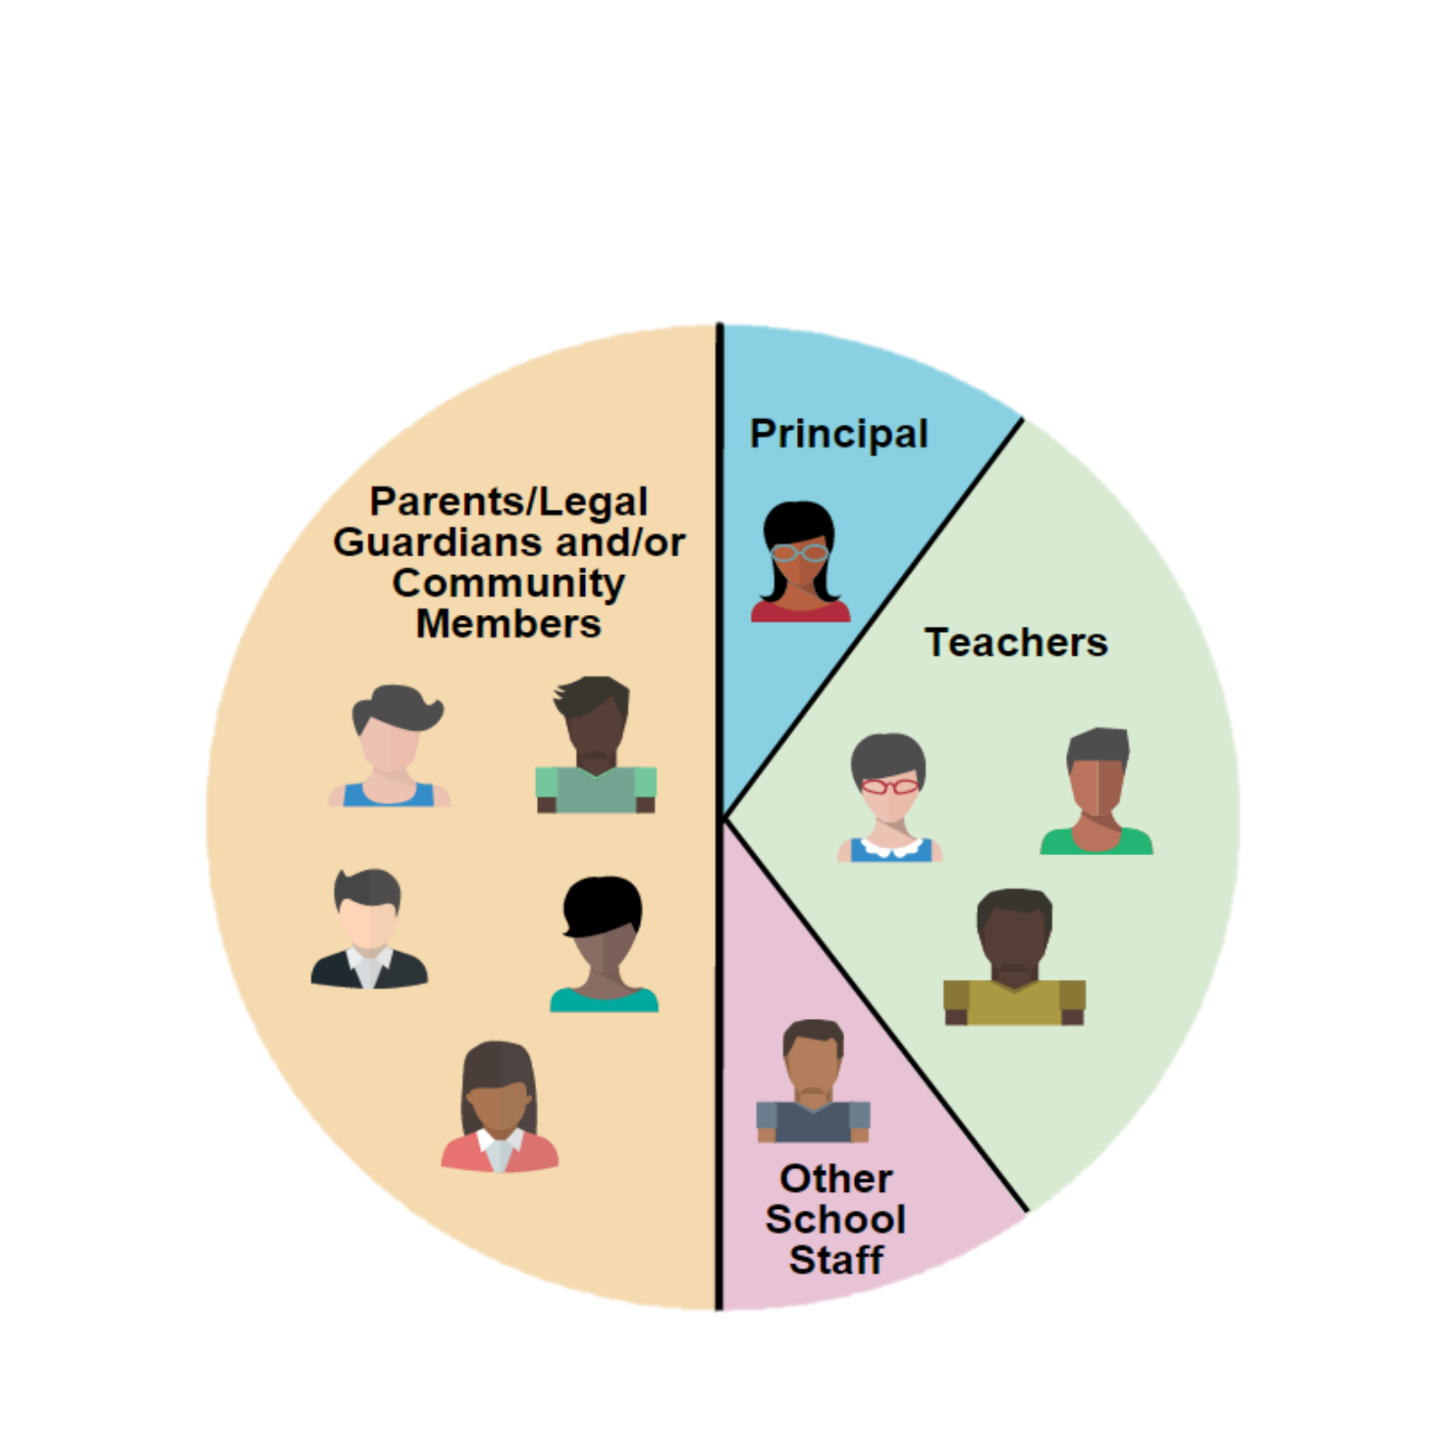
SSC ELEMENTARY COMPOSITION*
CONFIGURACIÓN DEL SSC PARA ESCUELAS PRIMARIAS
SAMPLE
Muestra
Not employed at the child’s school
Parent Member:
Is an individual who is a mother, father or legal guardian not employed at the school with which the council is affiliated.
Community member:
Resides and/or works within a specific school’s attendance boundary. PROOF IS REQUIRED.
On an annual basis, parents designate by vote whether to assign their parent member seat(s) on the council to eligible community members.
Padre miembro:
Esta persona es madre, padre, o tutor legal quien no es empleado de la escuela con la que está afiliada el consejo.
Miembro de la Comunidad:
Vive y/o trabaja dentro de los límites específicos de asistencia escolar. SE REQUIERE COMPROBANTE.
Anualmente, mediante una votación, los padres indican si desean designar una plaza o más de padres en el comité a un miembro elegible de la comunidad.
Principal or designee
Director(a) o la persona designada.
No es empleado en la escuela del niño
Maestros
Otro Personal Escolar
All members must be elected by their peers, except the principal or his/her designee, who is the only automatic member.
Todos los miembros deben ser electos por el grupo que representa, excepto al director escolar o la persona que él/ella designe, es el único miembro automático
Notes:
This slide describes the composition of the SSC at our elementary school.
Read slide if appropriate and explain composition which is describe in the bylaws.

Slide 30
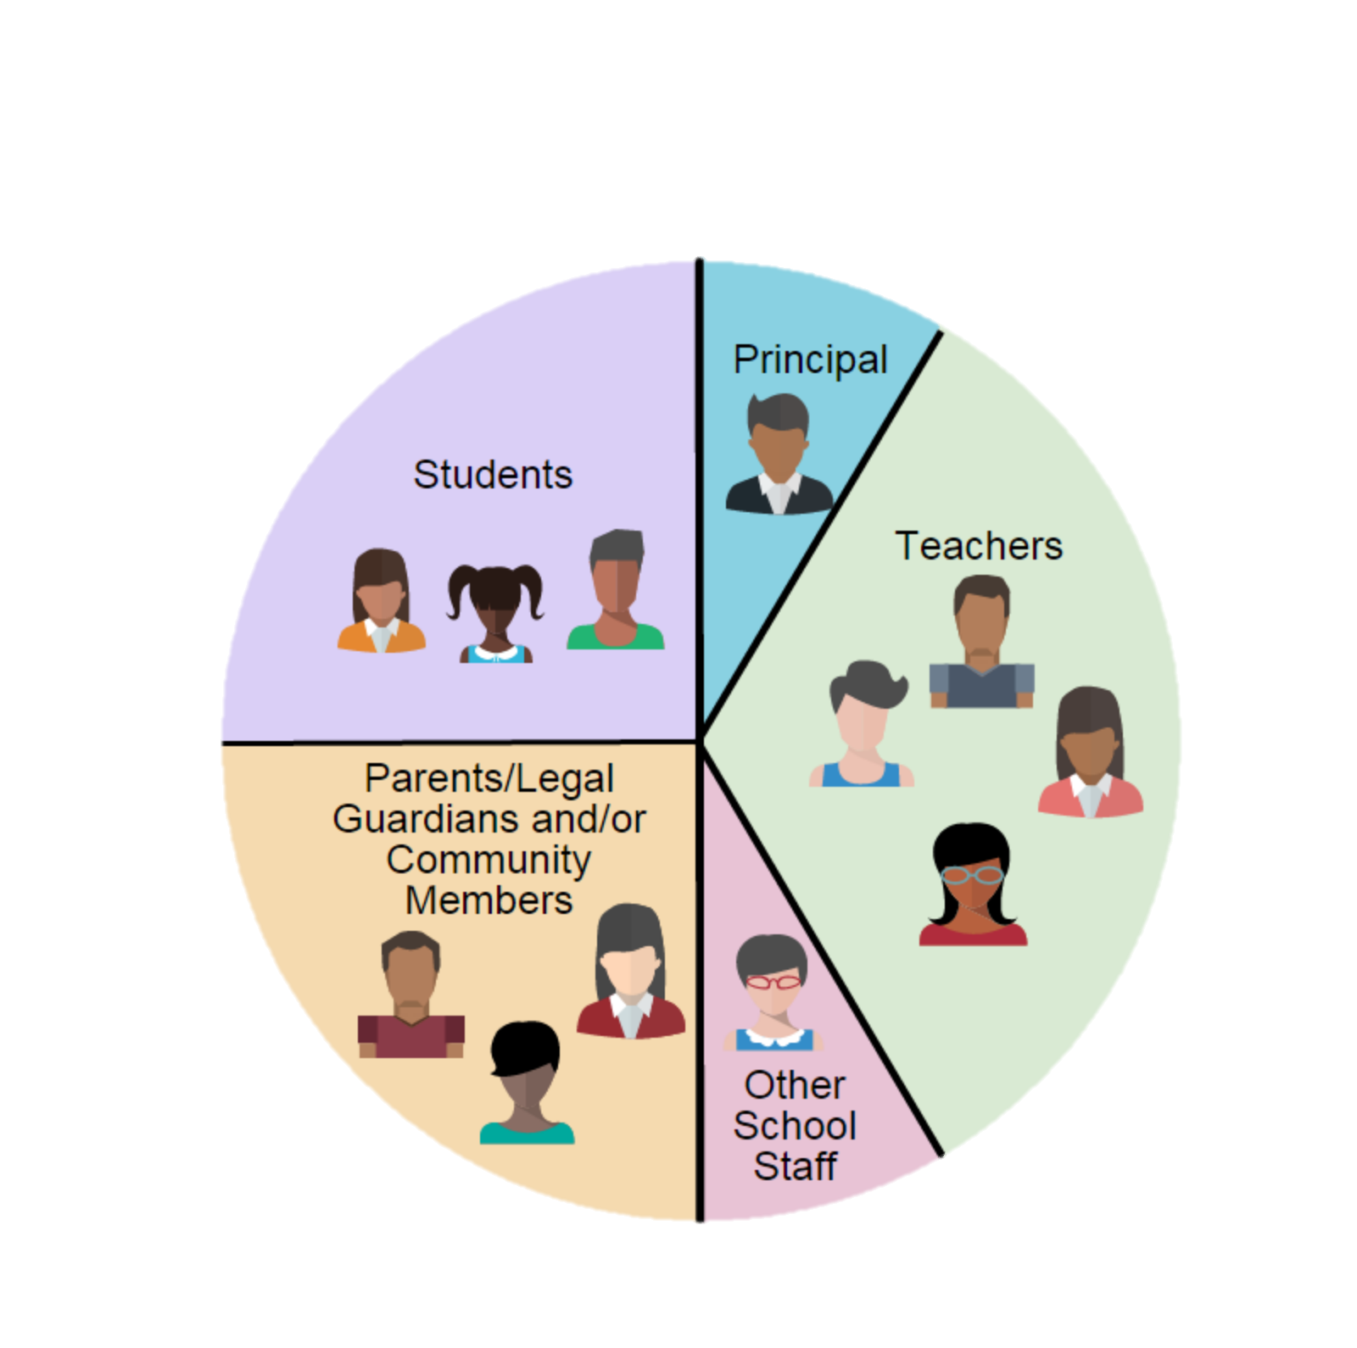
SSC SECONDARY COMPOSITION*
CONFIGURACIÓN DEL SSC PARA ESCUELAS SECUNDARIAS*
SAMPLE
Muestra
Principal
De conformidad con la sección 65000 del Código de Educación del Estado de California, para las escuelas de nivel secundario:
  se requiere paridad entre los padres de familia/comunidad y los estudiantes
  se requiere paridad entre las personas que son empleados y las que no lo son.
  el SSC debe de contar con mínimamente 12 miembros.
Conforme la sección 33133 (c) del Código de Educación del Estado de California, en las escuelas intermedias, un SSC puede, pero no se le requiere, que incluya representación estudiantil.
According to California Education Code, section 65000, for secondary schools:
  parity between parents/community and students is required
  parity between staff and non-staff is required
  the SSC must be composed of at least 12 members
According to the California Education Code, section 33133(c), at middle schools, a SSC may, but is not required to, include student representation.
Director(a) o la persona designada.
25%
Parents/
Legal Guardian
Community
25%
Student (Secondary)
Teacher
Maestros
Estudiantes
Not employed at the child’s school
No es empleado en la escuela del niño
Otro Personal Escolar
All members must be elected by their peers, except the principal or his/her designee, who is the only automatic member.
Todos los miembros deben ser electos por el grupo que representa, excepto al director escolar o la persona que él/ella designe, es el único miembro automático
Notes:
Read this slide if applicable. There have been changes in the secondary composition with regards to parity. Please review the bulletin 6745.2 (page… and Attachment R) for more information.

Slide 31
SSC ALTERNATES
OPTIONAL
SUPLENTES DEL SSC
OPCIONAL
Election of alternates for the council is optional.
Alternates should be elected for all stakeholder groups e.g. teachers, parents, students, and other school personnel, except the principal or designee.
The principal’s designee is not an alternate but a member of the SSC.
Alternates are not members until seated to replace current members upon a termination or resignation of membership.
Alternates do not have voting privileges and are not counted for the establishment of quorum, until seated to replace a member that can no longer serve. (Refer to Attachment B1)
La elección de suplentes para el consejo o comité es opcional.
Se debe de elegir a suplentes para todas las partes interesadas como los maestros, padres, estudiantes y otros empleados escolares, excepto para el director escolar o la persona designada.
La persona designada por el director escolar no es un suplente, pero es miembro del SSC.
Los suplentes no son miembros hasta que toman posesión del puesto para reemplazar a miembros actuales que han presentado una renuncia o por un cese de membresía.
Los suplentes no tienen privilegio al voto y no cuentan para establecer quórum, hasta que sean aceptados para remplazar a un miembro que ya no sea capaz de fungir en su cargo. (Ver el Adjunto B1)
Notes:
Read slide with regards to alternates.

Slide 32
School Site Council
OFFICERS
FUNCIONARIOS
DEL SSC
CHAIRPERSON
Preside at all meetings.
Sign all letters, reports and other communications of the council.
Perform all duties relevant to the office of the Chairperson.
Participate in the planning of the meeting agendas.
Have other such duties as are prescribed by the council.
PRESIDENTE (A)
Presidir en todas las reuniones
Firmar todas las cartas, informes y cualquier otro tipo de comunicación del consejo.
Desempeñar otros deberes apropiados para el cargo de Presidente(a).
Participar en la planificación de las agendas para la reunión.
Desempeñar otras responsabilidades según lo establezca el consejo.
Notes:
There are 4 officers for the SSC. Read slides
Once we have all SSC members elected (teachers, Other Personnel) we will hold officers election. Today we will only select _______ parent/community members.

Slide 33
School Site Council
OFFICERS
FUNCIONARIOS
DEL SSC
VICE-CHAIRPERSON
Represent the Chairperson in assigned duties.
Substitute for the Chairperson in his or her absence.
Participate in the planning of the agenda.
VICE-PRESIDENTE(A)
Representar al Presidente(a) en sus deberes asignados.
Sustituir al Presidente(a) en su ausencia.
Participar en la planificación de la agenda
Notes:
There are 4 officers for the SSC. Read slides
Once we have all SSC members elected (teachers, Other Personnel) we will hold officers election. Today we will only select _______ parent/community members.

Slide 34
School Site Council
OFFICERS
FUNCIONARIOS
DEL SSC
SECRETARY
Conduct roll call to establish quorum.
Keep minutes of all regular and additional meetings of the council.
Provide the signed and dated original meeting minutes to the principal or designee.
Assist in keeping the records of the council.
Maintain a current roster of the council members.
Perform other such duties as are assigned by the Chairperson.
Participate in the planning of the agenda.
SECRETARIO(A)
Pasar lista para establecer quórum
Llevar registro de todas las reuniones ordinarias y reuniones adicionales del consejo.
Proveer la copia original del acta firmada y fechada al director o persona asignada.
Ayudar con mantener los registros del consejo.
Mantener una lista actualizada de los miembros del consejo.
Desempeñar otros deberes que son asignados por el Presidente(a)
Participar en la planificación de la agenda
Notes:
There are 4 officers for the SSC. Read slides
Once we have all SSC members elected (teachers, Other Personnel) we will hold officers election. Today we will only select _______ parent/community members.

Slide 35
School Site Council
OFFICERS
FUNCIONARIOS
DEL SSC
PARLIAMENTARIAN
Assist the Chairperson in ensuring all rules and bylaws are followed.
Be knowledgeable about the California Open Meeting Law (Greene Act), District policies, bylaws of the council, and selected parliamentary procedures.
Participate in the planning of the agenda.
REPRESENTANTE PARLAMENTARIO
Ayudar al Presidente(a) para garantizar que todos los reglamentos y estatutos se cumplan.
Tener conocimientos del Decreto de Reuniones Abiertas (Decreto Greene), las políticas del Distrito, los estatutos del consejo y de los selectos procedimientos parlamentarios.
Participar en la planificación de la agenda
Notes:
There are 4 officers for the SSC. Read slides
Once we have all SSC members elected (teachers, Other Personnel) we will hold officers election. Today we will only select _______ parent/community members.

Slide 36
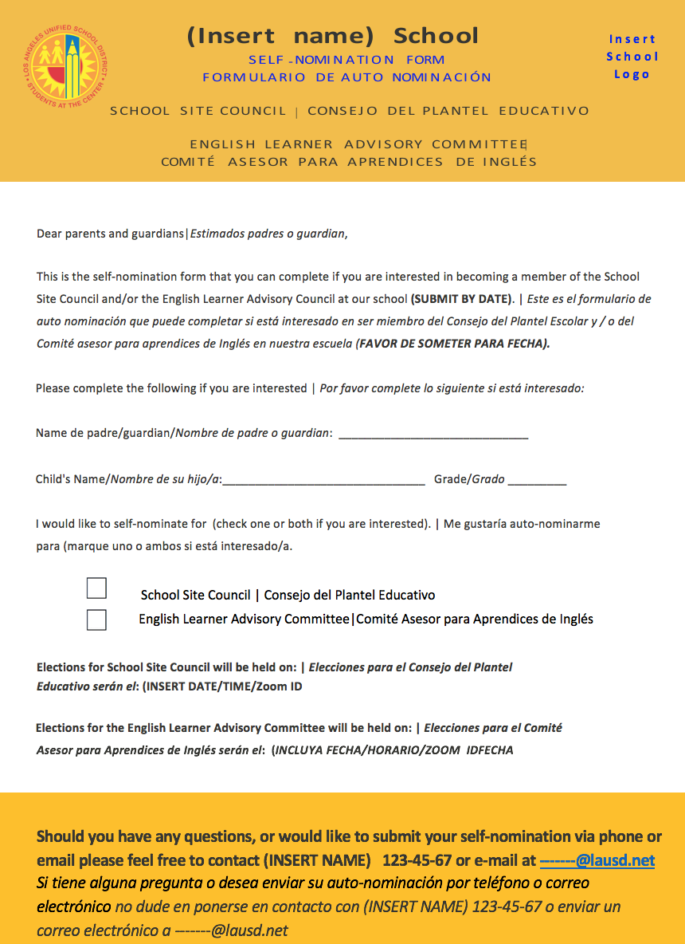
Options for Self-Nomination
Explain the process for distributing/collecting
Self-Nomination Forms
**INSERT
YOUR SCHOOL’S VERSION OF THE NOMINATION FORM (only for Orientation)
Notes:
Please note that if you submit your name for consideration to be a member of SSC.
You must be present the day of the election in order to be considered a candidate.

Slide 37

Questions? ¿Preguntas?

Slide 38

Break Descanso
Notes:
Please ask participants to stretch.

Slide 39
ORIENTATION FOR THE ENGLISH LEARNER ADVISORY COMMITTEE (ELAC)
ORIENTACIÓN PARA EL COMITÉ ASESOR PARA APRENDICES DE INGLÉS
(ELAC, por sus siglas en inglés)
Schools and families working together to ensure student success
Escuelas y familias trabajando unidas para asegurar el éxito estudiantil
BUL 6745.2 Guidelines for the Required School Site Council and English Learner Advisory Committee
BUL 6745.2 Normas para el Requerido Consejo del Plantel Escolar y el Comité Asesor para Aprendices de Inglés
Notes:
We are now going to start the orientation for the School Site Council. I will be explaining the role and responsibility of the SSC as described in BUL 6745.2 Guidelines for the Required School Site Council and English Learner Advisory Committee.

Slide 40
ENGLISH LEARNER ADVISORY COMMITTEE (ELAC)
COMITÉ ASESOR PARA APRENDICES DE INGLÉS (ELAC)
In accordance with the California Education Code, section 52176(b), all schools with twenty-one or more English learner (EL) students, not including Reclassified Fluent English Proficient (RFEP) students, are required to establish an English Learner Advisory Committee (ELAC).
Schools are required to form the ELAC at any time during the school year when the number of identified EL students reaches 21 or more. All parents with students attending the school in which the ELAC is established are eligible and should be encouraged to participate in the ELAC.
The principal must ensure that ELAC members receive appropriate training.
De acuerdo con la sección 52176 (b) del Código de Educación de California, todas las escuelas con veintiún (21) o más estudiantes Aprendices de Inglés (EL), sin incluir a los estudiantes Reclasificados como Competentes en el Idioma Inglés (RFEP), deben establecer un Comité Asesor para Aprendices de Inglés (ELAC).
Se requiere que las escuelas establezcan un ELAC en cualquier momento durante el año escolar cuando el número de estudiantes identificados como aprendices de inglés llegue a ser 21 ó más. Todos los padres con estudiantes que asisten a la escuela en la que se establece el ELAC, son elegibles y se les debe animar para que participen en el ELAC.
El director debe asegurarse que los miembros del ELAC reciban la capacitación apropiada.
Notes:
Read slides to indicate why we have an ELAC. We currently have over ____ English Learners in our school

Slide 41
ELAC FUNCTIONS AND RESPONSIBILITIES
DEBERES Y RESPONSABILIDADES DE ELAC
Proporcionar recomendaciones por escrito al SSC en relación a los programas y los servicios para los estudiantes EL (ver Adjunto G.) Las recomendaciones deben basarse en el desempeño de los estudiantes y en datos de la inclusión de los padres.
Asesorar respecto al desarrollo del SPSA en relación al Plan Maestro para Aprendices de Inglés.
Asesorar en relación a los esfuerzos para informar a los padres acerca de la importancia de la asistencia regular a la escuela, revisar los datos de asistencia estudiantil y la política del Distrito para la asistencia estudiantil.
Provide written recommendations to the SSC regarding programs and services for EL students (see Attachment G). Recommendations should be based on student performance and parental involvement data.
Advise on the development of the SPSA in relation to the English Learner Master Plan.
Advise on efforts to inform parents about the importance of regular school attendance, review the school’s student attendance data and the District’s student attendance policy.
Notes:
This slide outlines ELAC responsibilities.

Slide 42
ELAC FUNCTIONS AND RESPONSIBILITIES
DEBERES Y RESPONSABILIDADES DE ELAC
Include on the meeting agendas information related to the District’s Master Plan for English Learners and Standard English Learners.
Use the Comprehensive School Needs Assessment to identify and address the linguistic and academic needs of EL students and to develop training and support for parents.
Incluir en la agenda para la reunión la información relacionada con todos los ámbitos del Plan Maestro del Distrito para Aprendices de Inglés y Aprendices de Inglés Estándar.
Utilizar la Evaluación Integral de Necesidades Escolares para identificar y responder a las necesidades lingüísticas y académicas de los estudiantes EL y para crear capacitación y apoyo para los padres.
Notes:
This slide outlines ELAC responsibilities.

Slide 43
ELAC FUNCTIONS AND RESPONSIBILITIES
DEBERES Y RESPONSABILIDADES DE ELAC
Convene six times per year at a time that is agreeable to members. These six meetings do not include a mandatory orientation and election.
Adhere to the Greene Act as required by California Education Code 35147, provided bylaws (see Section V and Attachment B2) and Robert’s Rules of Order (see Attachment M).1
Reunirse seis veces al año a una hora que sea conveniente para los miembros. Estas seis reuniones no incluyen la reunión obligatoria de orientación, ni la reunión de elección.
Respetar el Decreto Greene como lo requiere la sección 35147 del Código de Educación de California, los estatutos provistos (consultar la Sección V y el Adjunto B2) y el Reglamento del Orden Parlamentario de Robert (consultar el Adjunto M.)
Notes:
Read slides

Slide 44
ELAC FUNCTIONS AND RESPONSIBILITIES
DEBERES Y RESPONSABILIDADES DE ELAC
Maintain the following documents on file (scanned electronic or hard copy) in a secure location for five years and be available for review during District, state and federal compliance reviews: orientation and election meeting announcements, ballots, minutes, records of attendance, agendas, handouts, documentation that verifies the requirements of member eligibility ELAC recommendations to the SSC, SSC responses, official correspondence, and ELAC bylaws.
Mantener los siguientes documentos archivados (copia electrónica o en papel) en un lugar seguro durante cinco años y tenerlos disponibles para revisión durante las visitas de acatamiento estatales, federales y del Distrito: anuncios de la reunión de orientación y de la reunión de elecciones, boletas electorales, actas, registros de asistencia, agendas, documentos que verifican los requisitos de elegibilidad para los miembros, recomendaciones del ELAC al SSC, respuesta del SSC, correspondencia oficial y los estatutos de ELAC.
Notes:
Read slides

Slide 45


ELAC RECOMMENDATION PROCESS
EL PROCESO PARA LAS RECOMENDACIONES DE PARTE DE ELAC
El Comité Asesor para los Aprendices de Inglés
envía recomendaciones escritas al SSC.
English Learner
Advisory Committee
sends written recommendations to the SSC.
El SSC contesta a las recomendaciones escritas dentro de 30 días o en la próxima reunión oficial del SSC.
SSC must respond to written recommendations within 30 days, or at the next official SSC meeting.
Notes:
This is an important responsibility for ELAC. The committee members are to write recommendations to the SSC which will support English learners in the school. ELAC members are advisory only…they need to submit recommendations to the school’s decision making council. Then the SSC committee must consider the ELAC written recommendation and respond within the 30.

Slide 46
ELAC COMPOSITION
CONFIGURACIÓN DE ELAC
Parents and legal guardians of EL students, not employed by LAUSD, must constitute at least 51% of the total membership of the ELAC.
However, when the percentage of EL students in a school constitutes more than 51% of the total number of students, parents and legal guardians of EL students must equal or exceed the percentage of EL students in the school.
Los padres y tutores legales de los estudiantes aprendices de inglés que no son empleados de LAUSD, deben constituir por lo menos el 51% de la membresía del ELAC.
Sin embargo, cuando el porcentaje de los estudiantes EL constituye más del 51% del número de la población total de los estudiantes, los padres y tutores legales de los estudiantes EL deben constituir equitativamente o exceder el porcentaje de estudiantes EL en la escuela.
Notes:
Presenter notes:
ELAC in at least the same percentage as their children represent of the total number of pupils in the school.
Parents of non-EL students, not employed by the District.

Slide 47
ELAC COMPOSITION
CONFIGURACIÓN DE ELAC
The minimum number of ELAC members will depend on the number of English learner students in a school. The required number of ELAC members will be as follows:
El número mínimo de miembros de ELAC dependerá del número de Aprendices de Inglés matriculados en la escuela. El número requerido para miembros de ELAC será de la siguiente manera:
Number of English learners in a School Número de Aprendices de Inglés en la Escuela | Minimum Number of ELAC Members Required Número Mínimo de Miembros Requeridos para ELAC
21 to 75 ELs | A minimum of 3 total members required Se requiere un mínimo de 3 miembros en total
76 to 150 ELs | A minimum of 5 total members required Se requiere un mínimo de 5 miembros en total
151 to 225 ELs | A minimum of 7 total members required Se requiere un mínimo de 7 miembros en total
226 ELs and above | A minimum of 9 total members required Se requiere un mínimo de 9 miembros en total
Notes:
Our school has the following number of English learners therefore we will have a minimum number of ELAC members.

Slide 48
ELAC OFFICERS
FUNCIONARIOS DE ELAC
CHAIRPERSON
Preside at all meetings of the ELAC.
Sign all letters, reports and other communications of the ELAC.
Perform all duties relevant to the office of the chairperson.
Participate in planning of meeting agendas.
Have other such duties as prescribed by the ELAC.
Serve as the school’s representative to the Local District ELAC Delegate Convening for DELAC Elections (no alternate will be allowed to participate in this role).
PRESIDENTE (A)
Presidir en todas las reuniones del ELAC.
Firmar todas las cartas, informes y cualquier otro tipo de comunicación de ELAC.
Desempeñar otros deberes apropiados para el cargo de Presidente.
Participar en la planificación de la agenda de las reuniones.
Desempeñar otros deberes asignados por ELAC.
Fungir como el representante de la escuela en la Convocatoria de delegados ELAC a nivel Distrito Local para Elecciones de DELAC (no se permitirá que suplentes desempeñen este deber).
Notes:
ELAC will have four officers. Read the slides for each officers.

Slide 49
ELAC OFFICERS
FUNCIONARIOS DE ELAC
VICE-CHAIRPERSON
Represent the chairperson in assigned duties.
Substitute for the chairperson in his or her absence, except at Delegate Convening.
Participate in planning of the agenda.
VICE PRESIDENTE (A)
Representar al Presidente en sus deberes asignados.
Sustituir al Presidente en su ausencia, excepto en la Convocatoria de Delegados.
Participar en la planificación de la agenda.
Notes:
ELAC will have four officers. Read the slides for each officers.

Slide 50
ELAC OFFICERS
FUNCIONARIOS DE ELAC
SECRETARY
Keep minutes of all ELAC meetings of the ELAC.
Transmit true and correct copies of meeting minutes to members of the ELAC.
Assist in the maintenance of ELAC records.
Maintain a current roster of ELAC members.
Participate in planning of the agenda.
Perform other such duties as are assigned by the chairperson of the ELAC.
SECRETARIO(A)
Registrar las actas en todas las juntas de ELAC
Proporcionar a los miembros de ELAC copias correctas y verdaderas de las actas de las reuniones
Ayudar con mantener los registros de ELAC
Mantener una lista actualizada de los miembros del ELAC.
Participar en la planificación de la agenda.
Desempeñar otros deberes asignados por el Presidente del ELAC.
Notes:
ELAC will have four officers. Read the slides for each officers.

Slide 51
ELAC OFFICERS
FUNCIONARIOS DE ELAC
PARLIAMENTARIAN
Assist the chairperson in ensuring all rules and bylaws are followed.
Vote on any matter submitted for a vote.
Be knowledgeable about parliamentary procedure, ELAC bylaws, Robert’s Rules of Order and the California Open Meeting Law (Greene Act).
Participate in planning of the agenda.
REPRESENTANTE PARLAMENTARIO
Ayudar al Presidente para garantizar que todos los reglamentos y estatutos se cumplan.
Participar en la votación de cualquier asunto que se someta a voto.
Tener conocimientos acerca del procedimiento parlamentario, los estatutos de ELAC y los Reglamentos del Orden Parlamentario de Robert) y la Ley en California para Reuniones Abiertas (Decreto Greene).
Participar en la planificación de la agenda.
Notes:
ELAC will have four officers. Read the slides for each officers.

Slide 52
The following four slides on delegation of authority will not apply to most schools, and are only for schools that qualify, and whose ELAC considers going through the process, to delegate its authority and responsibilities to the School Site Council.
Las siguientes cuatro diapositivas sobre la delegación de autoridad no aplicarán a la mayoría de las escuelas y se hacen disponible solamente para las escuelas que califican y cuyos ELAC consideran pasar por el proceso de delegar su autoridad y responsabilidades al Consejo del Plantel Educativo.
Notes:
Review the following slides if the ELAC might want to delegate the authority to the SSC.

Slide 53
DELEGATION OF AUTHORITY
DELEGACIÓN DE AUTORIDAD
The ELAC may designate the SSC or the SSC EL Subcommittee to function as the advisory committee for English learners (Education Code 52176) only when all of the following occurs:
The percentage of English learners does not exceed 50% in elementary schools or 25% in secondary schools.
The SSC has an EL subcommittee.
Either the parent portion of the SSC or a SSC EL subcommittee reflects at least the same percentage of parents of English learners as EL students enrolled in the school.
El ELAC puede designar al SSC o el subcomité EL del SSC para fungir como el Comité Asesor para Aprendices de Inglés (Código de Educación 52176) solamente si todos los siguientes requisitos se cumplan:
El porcentaje de aprendices de inglés no excede del 50% en las escuelas primarias y del 25% en las escuelas secundarias.
El SSC cuenta con un subcomité ELAC.
La porción del SSC compuesta por los padres, tanto como la del subcomité de EL del SSC ambos deben tener por lo menos el mismo porcentaje de padres de estudiantes aprendices de inglés que están matriculados en la escuela bajo la clasificación de EL.
Notes:
Optional

Slide 54
DELEGATION OF AUTHORITY
DELEGACIÓN DE AUTORIDAD
Examples of EL Parent Portion on the SSC or SSC EL Subcommittee
 | #of SSC Members | # of students on SSC | # of parents on SSC | # of EL Parents on SSC | % of EL Parents on the parent portion of SSC | % of EL students in the school | ELAC is eligible to delegate authority to SSC? (Y/N)
Elementary Model | 10 | n/a | 5 | 2 | 40% | 46% | No
Elementary Model | 10 | n/a | 5 | 2 | 40% | 30% | Yes
*Secondary Model | 12 | 3 | 3 | 1 | 0% | 20% | No
*Secondary Model | 12 | 3 | 3 | 1 | 33% | 23% | Yes
Middle schools with no student representation | 12 | 0 | 6 | 3 | 17% | 24% | No
Middle schools with no student representation | 12 | 0 | 6 | 3 | 50% | 25% | Yes
*Secondary Model includes middle schools with student representation on their SSC.
Notes:
Optional

Slide 55
DELEGATION OF
AUTHORITY
DELEGACIÓN DE
AUTORIDAD
The delegation of authority cannot exceed two school years, including the school year during which delegation was approved by the PACE administrator.
ELAC members have been informed, during a regular (non-election) meeting, of the ELAC’s responsibilities prior to a vote to delegate authority to the SSC.
Discuss and vote, during an ELAC meeting at which quorum has been established, to delegate the ELAC responsibilities to the SSC.
A unanimous vote of the full ELAC membership present is required to approve delegation of authority to the SSC.
The decision must be documented in the ELAC meeting agenda and minutes.
La delegación de autoridad no puede ser para más de dos años, incluyendo el año escolar en el que la delegación fue aprobada por el administrador PACE.
Se informó a los miembros de ELAC durante una reunión ordinaria (no electoral), acerca de las responsabilidades de ELAC antes de votar por delegar su autoridad.
Discutir y votar, durante una reunión de ELAC en la que se establece quórum, por delegar las responsabilidades de ELAC al SSC.
Se requiere un voto unánime de toda la membresía de ELAC presente para aprobar la delegación de facultades al SSC.
La decisión debe registrarse en la agenda y el acta de la reunión del ELAC.
Notes:
Optional

Slide 56
DELEGATION OF
AUTHORITY
DELEGACIÓN DE
AUTORIDAD
SSC accepted the responsibilities of the ELAC by unanimous vote at a meeting in which quorum has been established.
The decision must be documented in the SSC meeting agenda and minutes.
Submission of a Delegation of Authority form (Attachment F) signed by the SSC and ELAC Chairpersons and the principal to the Local District Parent and Community Engagement Administrator for final approval.
ELAC and SSC members are informed once delegation of authority has been duly completed and approved.
SSC or SSC EL Subcommittee participates in training to address all ELAC responsibilities which include all mandated CA Education Code topics.
SSC aceptó las responsabilidades de ELAC por un voto unánime en una reunión en la cual se estableció quórum.
La decisión debe registrarse en la agenda y el acta de la reunión del SSC.
Se entregó el Formulario para Delegar Autoridad (Adjunto F) firmado por el presidente de SSC y de ELAC, así como por, al Director al Administrador para la Participación de los Padres y la Comunidad del Distrito Local para su aprobación final.
Se informa a los miembros del ELAC y SSC una vez que se haya completado y aprobado debidamente la delegación de autoridad.
SSC o el subcomité EL del SSC participa en la capacitación para atender todas las responsabilidades de ELAC la cual incluye todos los temas requeridos para consideración de ELAC por el Código de Educación de CA.
Notes:
Optional

Slide 57
Options for Self-Nomination
Explain the process for distributing/collecting Self-Nomination Forms
Explain that each nominee must be present at elections in order to be considered for membership.
**INSERT
YOUR SCHOOL’S VERSION OF THE NOMINATION FORM (only for Orientation)

Slide 58


Thank you
School Leaders
Gracias líderes escolares
Gracias por prestarse como voluntarios al formar parte de ELAC de la escuela. Reconocemos que pasarán tiempo participando en discusiones significativas e importantes con otros grupos de interés en relación al progreso académico, lingüísticos de los aprendices de inglés de la escuela, así como sus necesidades académicas y por medio de pedir al SSC de la escuela en nombre de los aprendices de inglés.
Gracias por prestarse como voluntarios al formar parte de SSC de la escuela. Sabemos que pasarán tiempo participando en discusiones significativas e importantes con otros grupos de interés en relación al SPSA de la escuela, el Plan de seguridad, los presupuestos categóricos y escuchando a las peticiones del comité ELAC de la escuela.
Informe al personal escolar si hay información adicional que necesita para tener un año exitoso como miembro de SSC/ELAC de la escuela.
Thank you for volunteering to be a part of your school’s ELAC. We know that you will be spending time engaged in meaningful and important discussions with other stakeholders regarding the school’s English learners academic progress, linguistic and academic needs of EL students, and providing request to the school’s SSC on behalf of English learners.
Thank you for volunteering to be a part of your school’s SSC. We know that you will be spending time engaged in meaningful and important discussions with other stakeholders regarding the school’s SPSA, Safety Plan, Categorical Budgets, and listening to request by the school’s ELAC committee.
Please let the school staff know if there is additional information that you need to have a successful year as a member of the school’s SSC/ELAC.

Slide 59
QUESTIONS? ¿Preguntas?

Slide 60
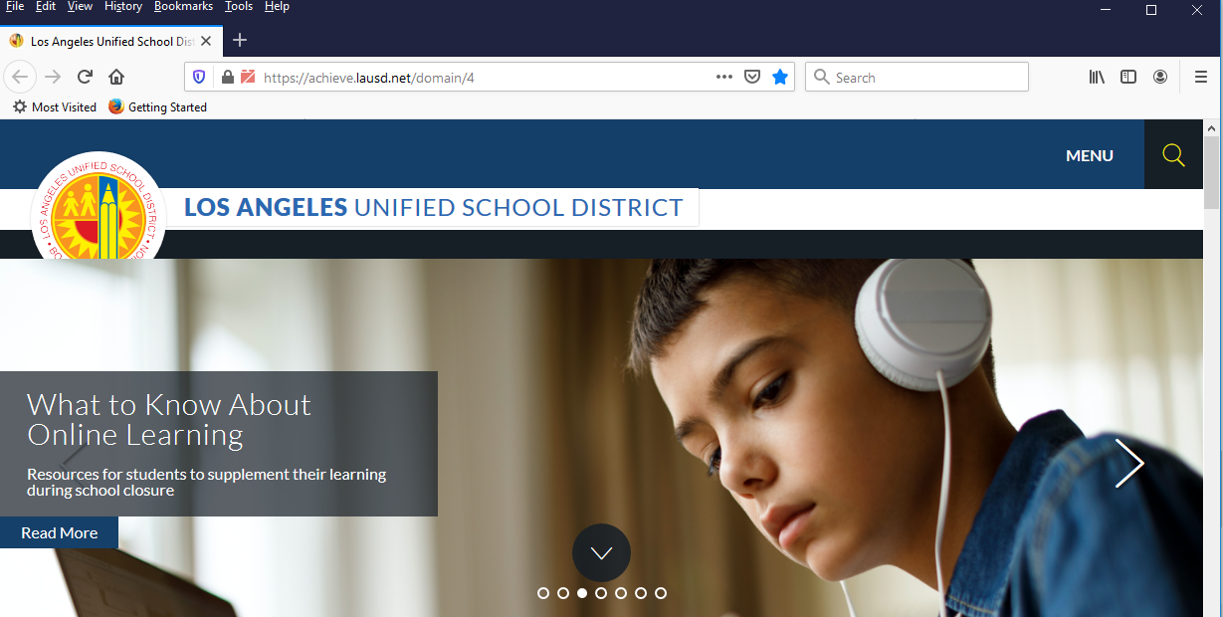
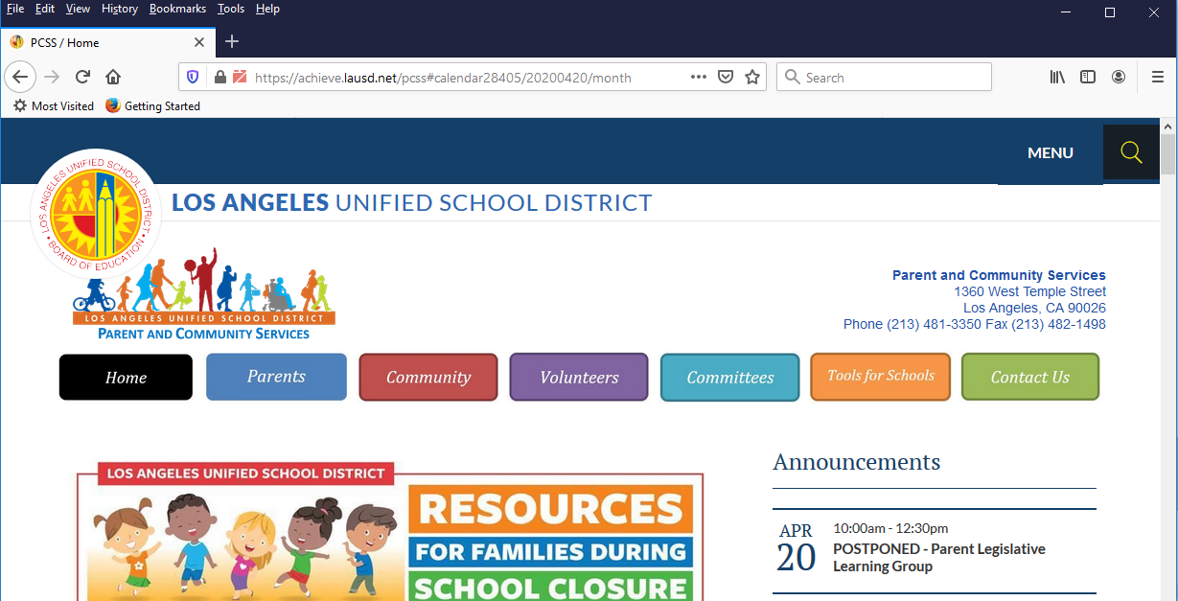
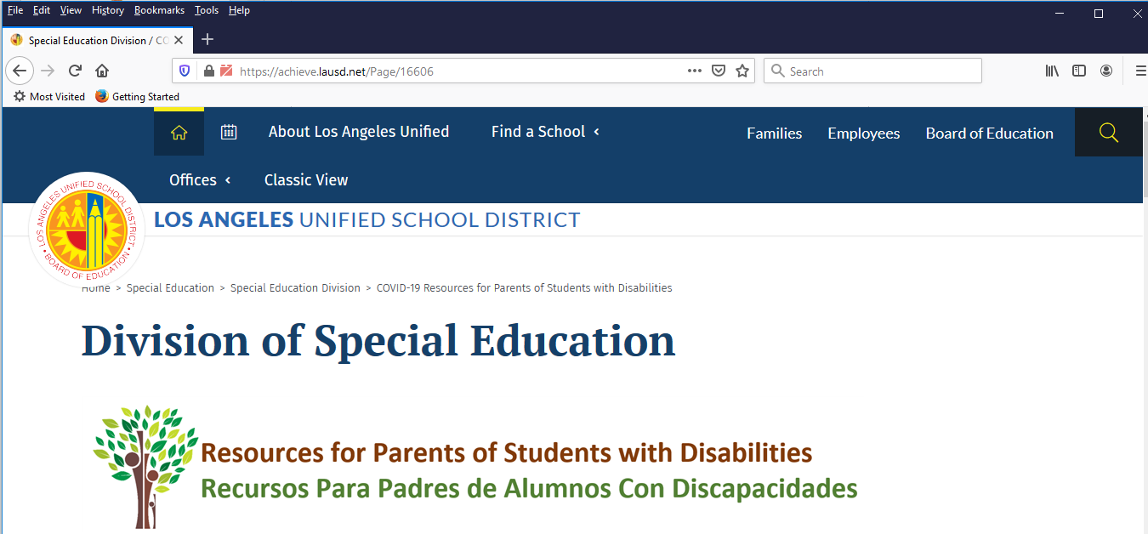
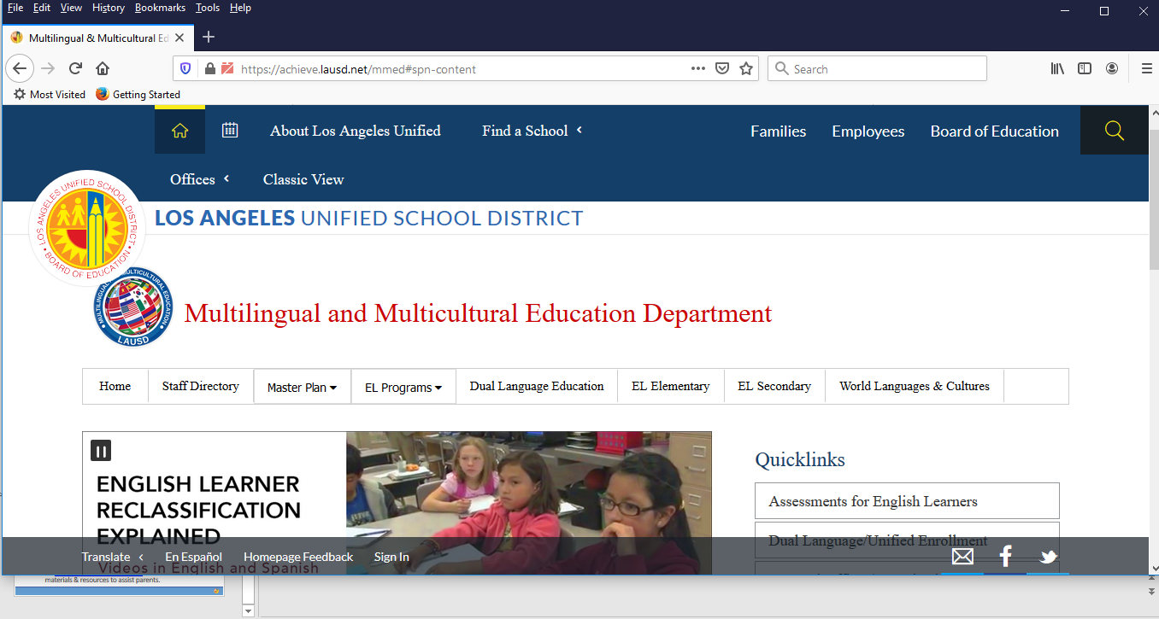
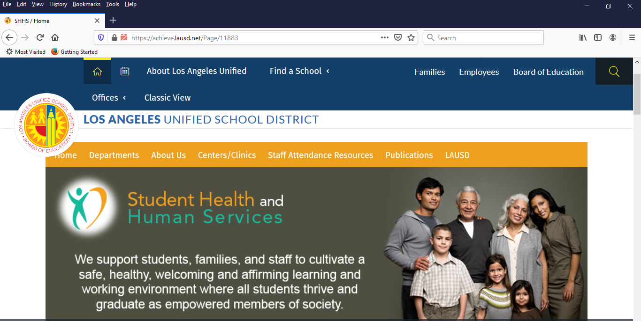
LAUSD District Offices Oficinas del Distrito de LAUSD
        Los Angeles Unified School District Office of Parent and Community Services Division of Special Education
        Distrito Escolar Unificado de Los Ángeles Oficina de Servicios para Padres y Comunidad División de Educación Especial
          https://achieve.lausd.net/resources https://achieve.lausd.net/pcss https://achieve.lausd.net/Page/16606
  Multilingual and Multicultural Education Department Student Health and Human Services
  Departamento de Educación Multilingüe y Multicultural Salud Estudiantil y Servicios Humanos
  https://achieve.lausd.net/mmed#spn-content https://achieve.lausd.net/Page/11883

Slide 61

Contact Information http://achieve.lausd.net/PCS
Información de contacto http://achieve.lausd.net/PCS
Local District Parent and Community Engagement Administrators
Administradores para la Participación de los Padres y la Comunidad del Distrito Local
Local District East | Elsa Tinoco | evt6292@lausd.net | (323) 224-3100
Local District Northeast | Patrizia Puccio | ppuccio@lausd.net | (818) 252-5400
Local District Northwest | Gonsalo Garay | ggg9445@lausd.net | (818) 654-3600
Local District West | Traci Calhoun | tlc4182@lausd.net | (310) 914-2100
Local District South | Debbie Siriwardene | dsiriwar@lausd.net | (310) 354-3400
Local District Central | Theresa Arreguin | iarregui@lausd.net | (213) 241-0100
Office of Parent and Community Services
Antonio Jr. Placsencia, Administrator
Diane Panossian, Director
Danny Dixon, Ed. D, Administrative Coordinator
Heidi Mahmud, Ed. D, Specialist
General number: (213) 481-3350
Gloria Acosta, Senior Facilitator
Leah Brackins, Senior Facilitator
Angie Cardenas, Senior Facilitators
Lisa Porter Houston, Senior Facilitator
Oficina de Servicios para los Padres y la Comunidad

